Slide 1
Political Science
Team IG:
Qi, Cindy, Yiru, Shicheng
11/15/2019

Slide 2
Research Question
Union density
Vocational training
Racial diversity
?

Slide 3
Steps and Concerns
Data
Check
Initial
EDA
Model
Check
1
2
3
Source
Year
Variables
Relationships
Replicate
Notes:
https://docs.google.com/spreadsheets/d/144sZfnpy8HRl-WHuJTUiOBRkkPwe2_M0Grnc3jBybKE/edit#gid=0

Slide 4
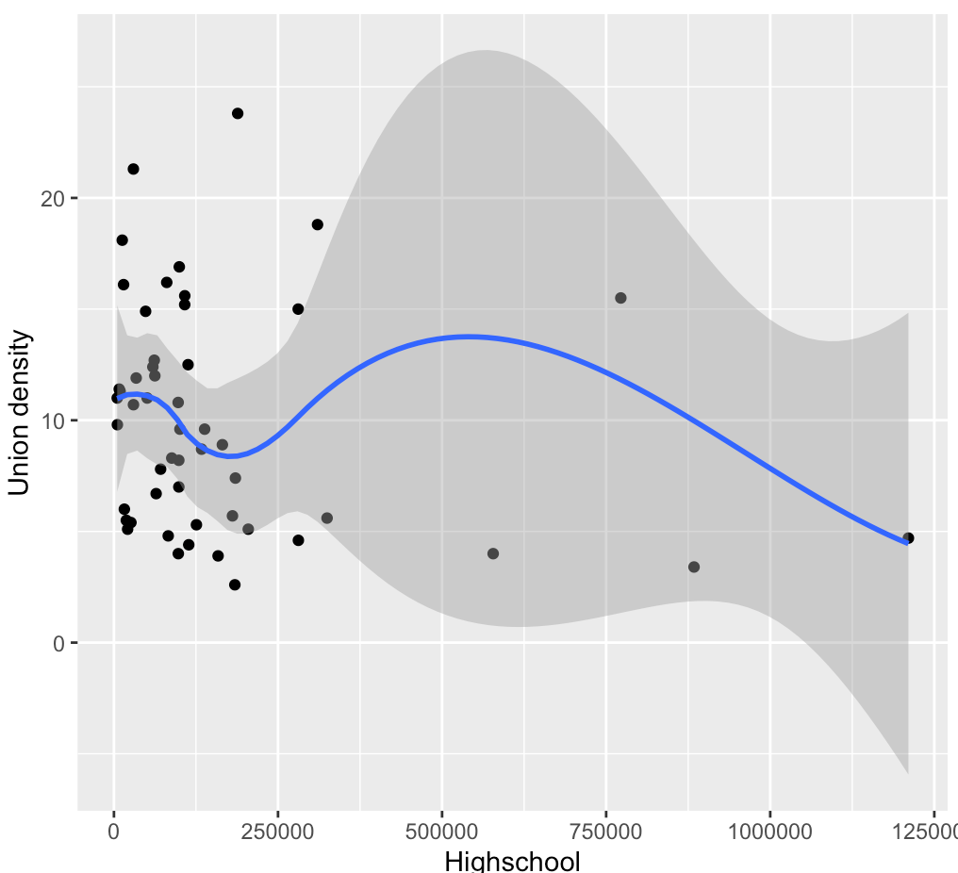
Initial EDA
Does the negative relationship exist? (Highschool versus Union density)

Slide 5
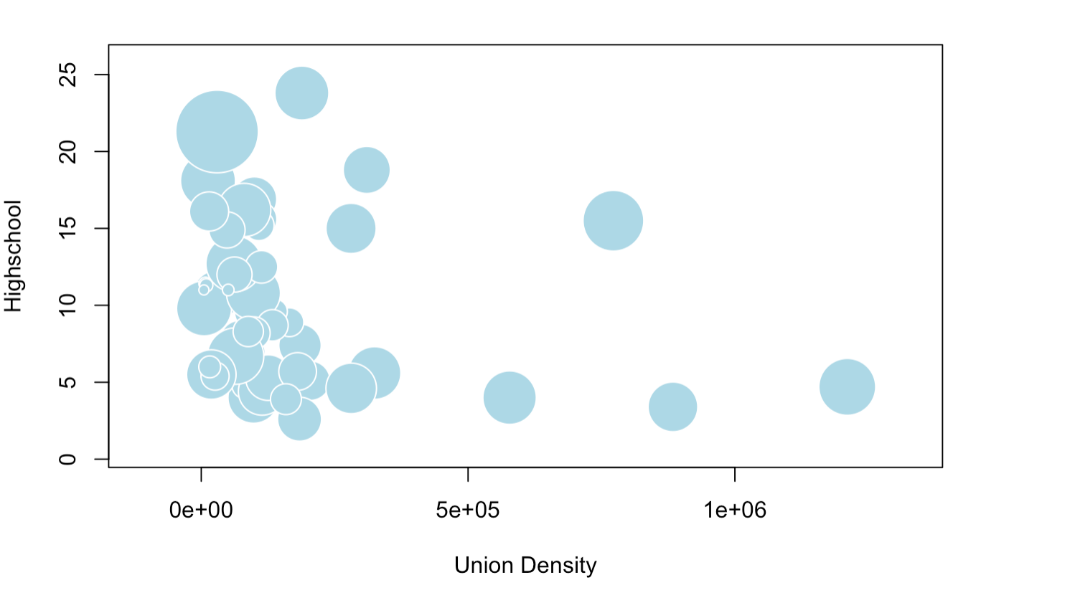
Initial EDA
Relationships when we add racial diversity
Radius=
Racial diversity

Slide 6
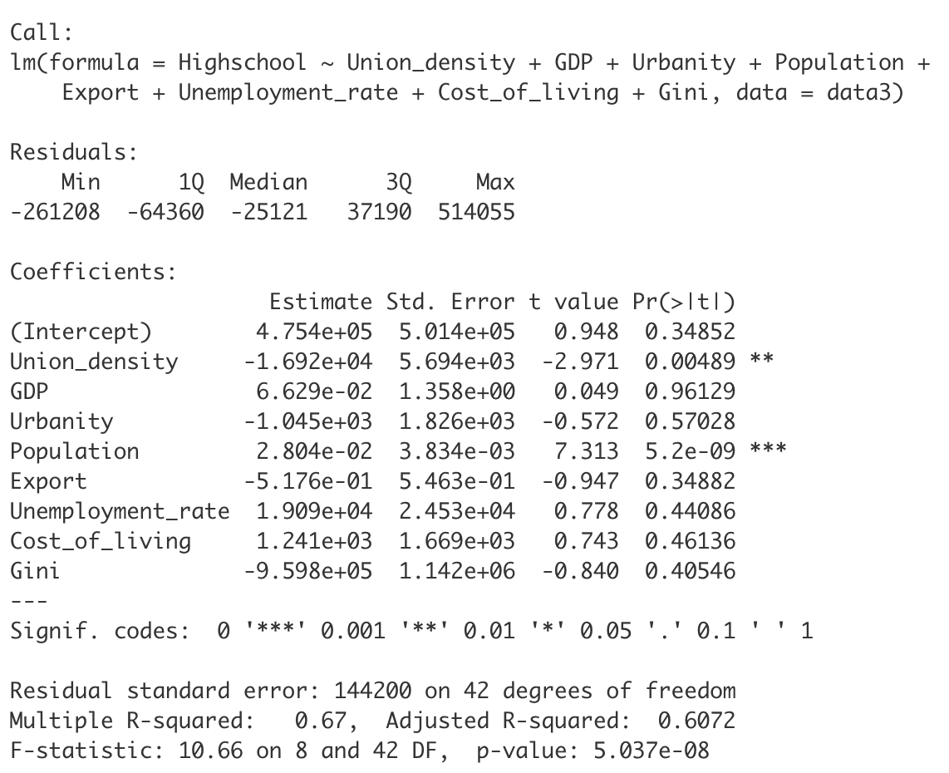
Model Check
Replicate your model
Outcome: Highschool
Predictor: Union density
Confounding variables: GDP, Urbanity, Population, Export, Cost of Living, Unemployment Rate, Gini

Slide 7
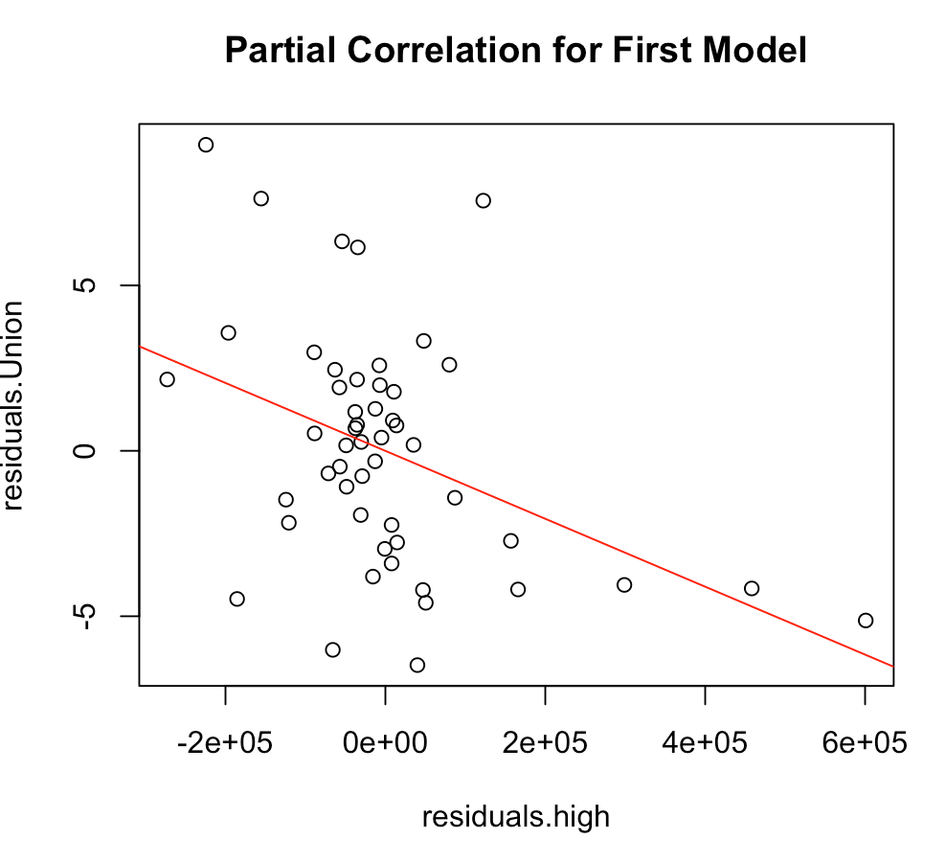
Partial Correlation Test
Control for confounding variables
Pearson (linear relationship)
Estimate: -0.4167
P-value = 0.0024
Spearman (monotonic relationship)
Estimate: -0.3665
P-value = 0.0082

Slide 8
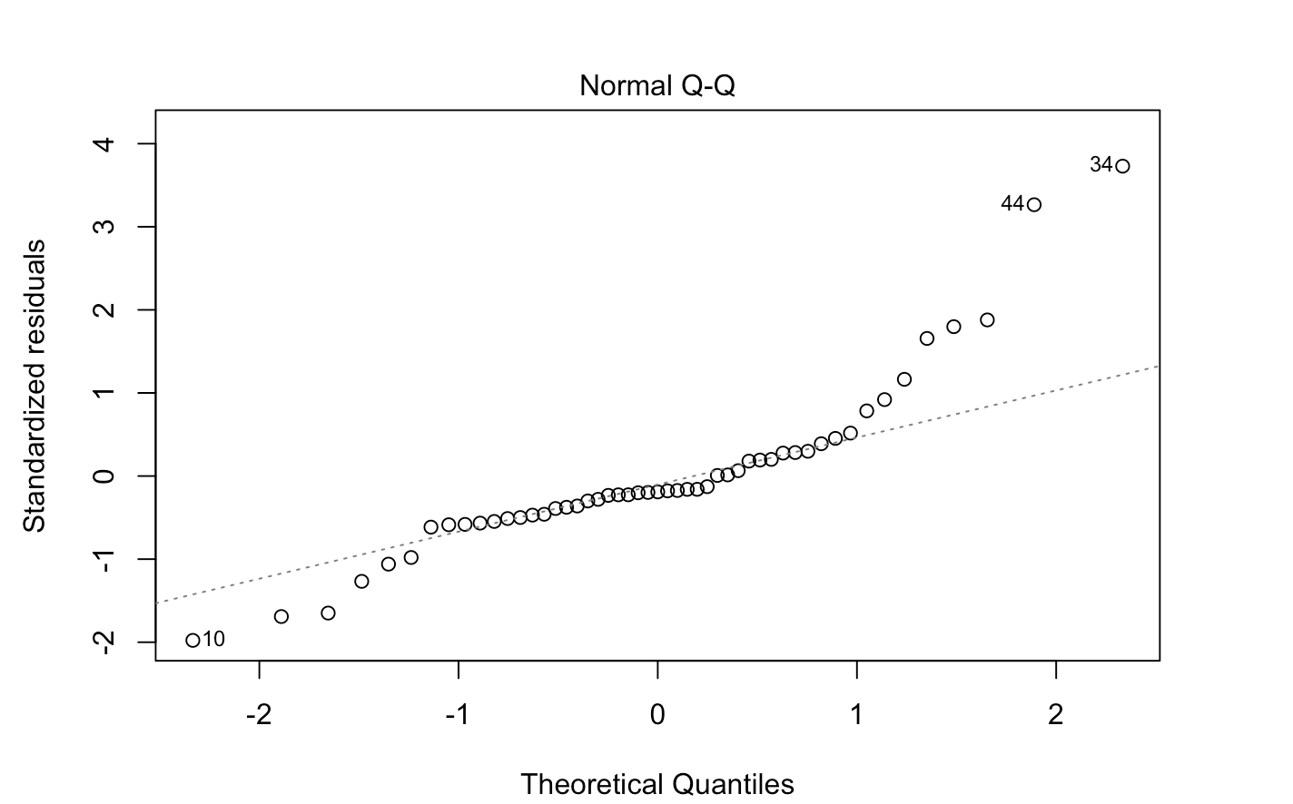
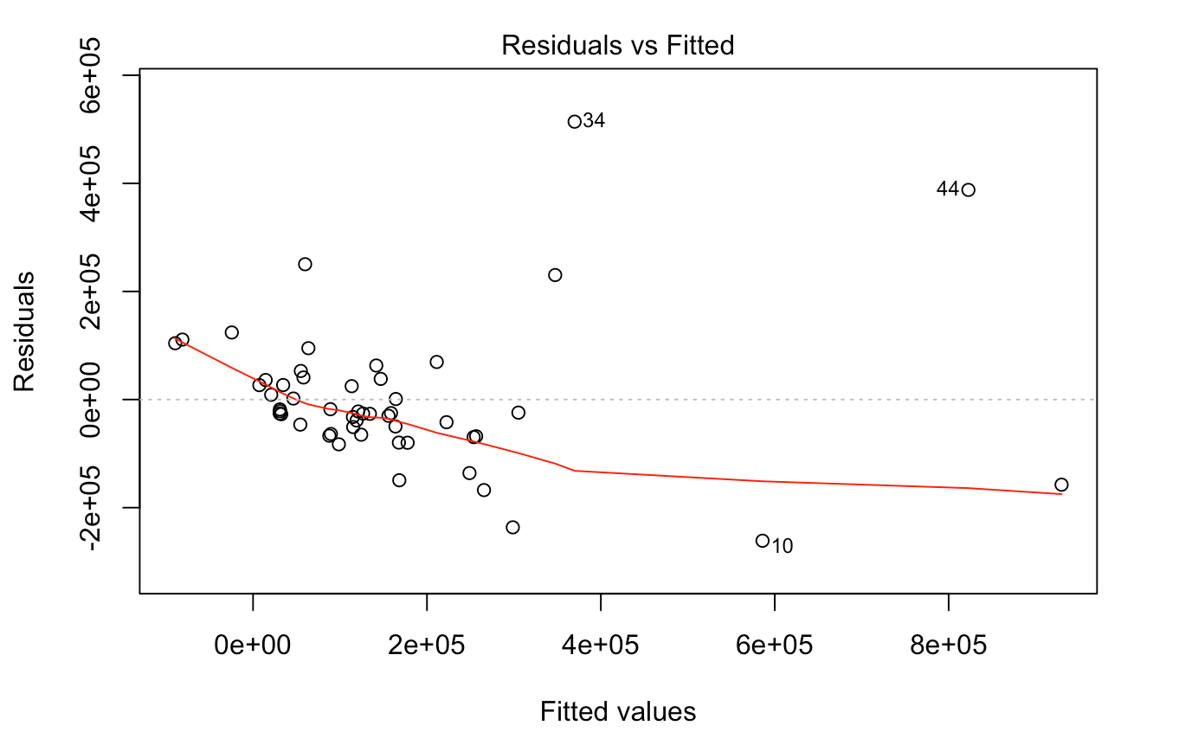
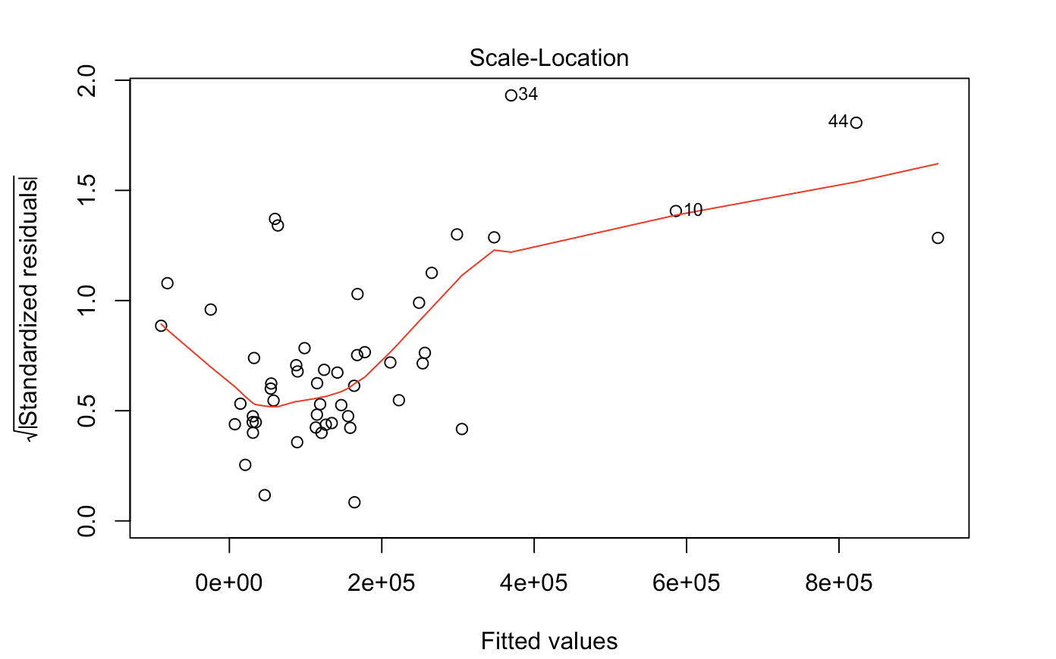
Assumptions
Normality Assumption
Linearity Assumption
Constant Variance Assumption

Slide 9
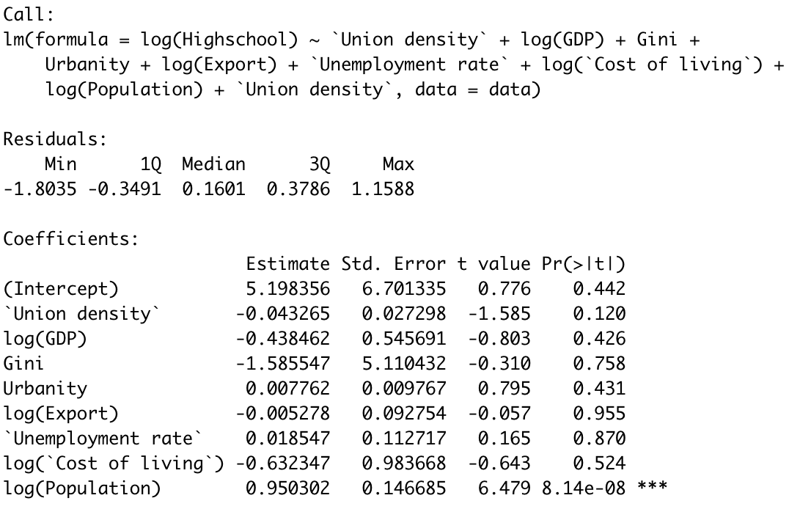
Transformation
Adjust the model
Outcome: log(Highschool)
Predictor: Union density
Confounding variable: log(GDP), Urbanity, log(Population), log(Export), log(Cost of Living), Unemployment Rate, Gini

Slide 10
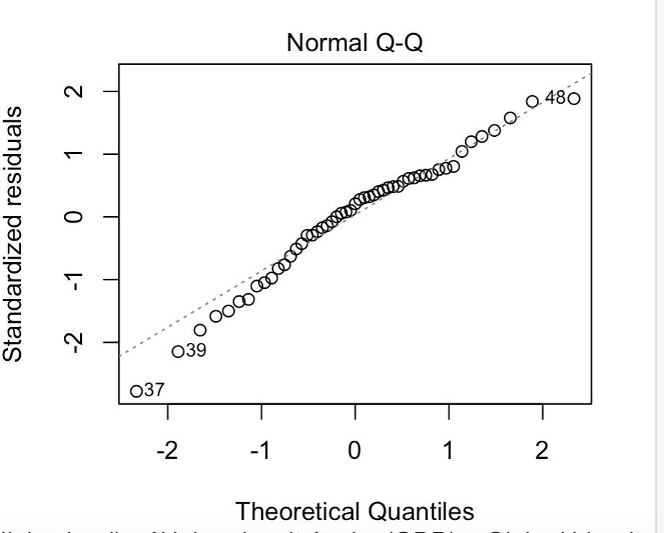
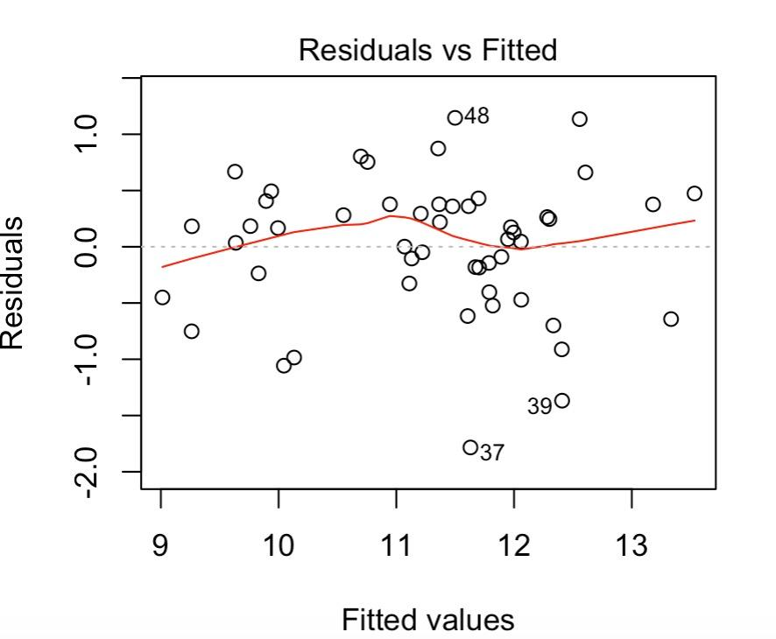
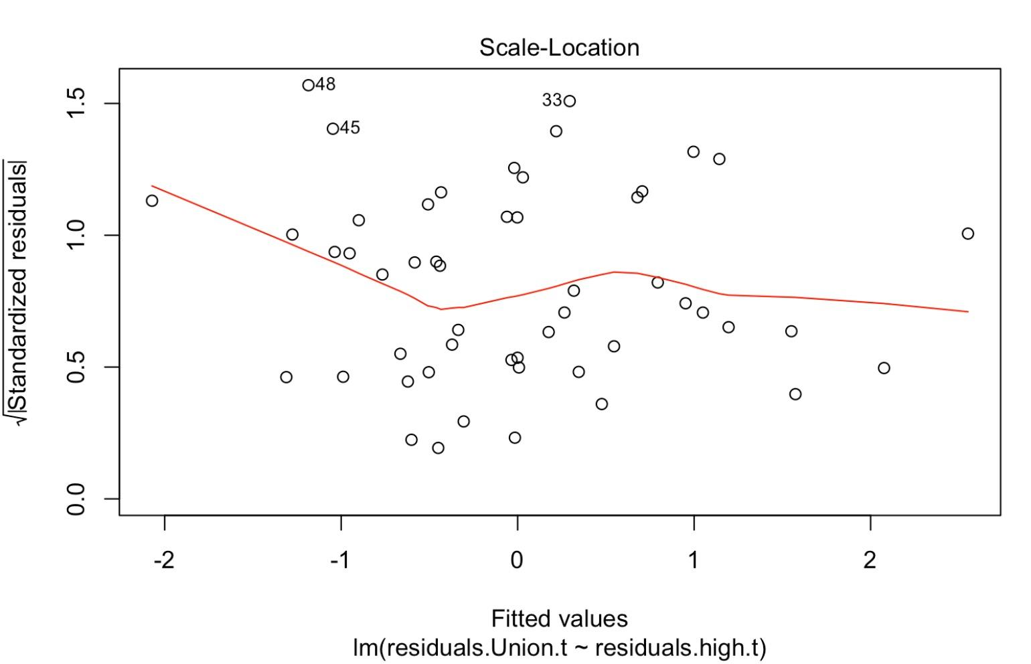
Transformation
Adjusted R^2 = 0.7202
Normality Assumption
Linearity Assumption
Constant Variance Assumption

Slide 11
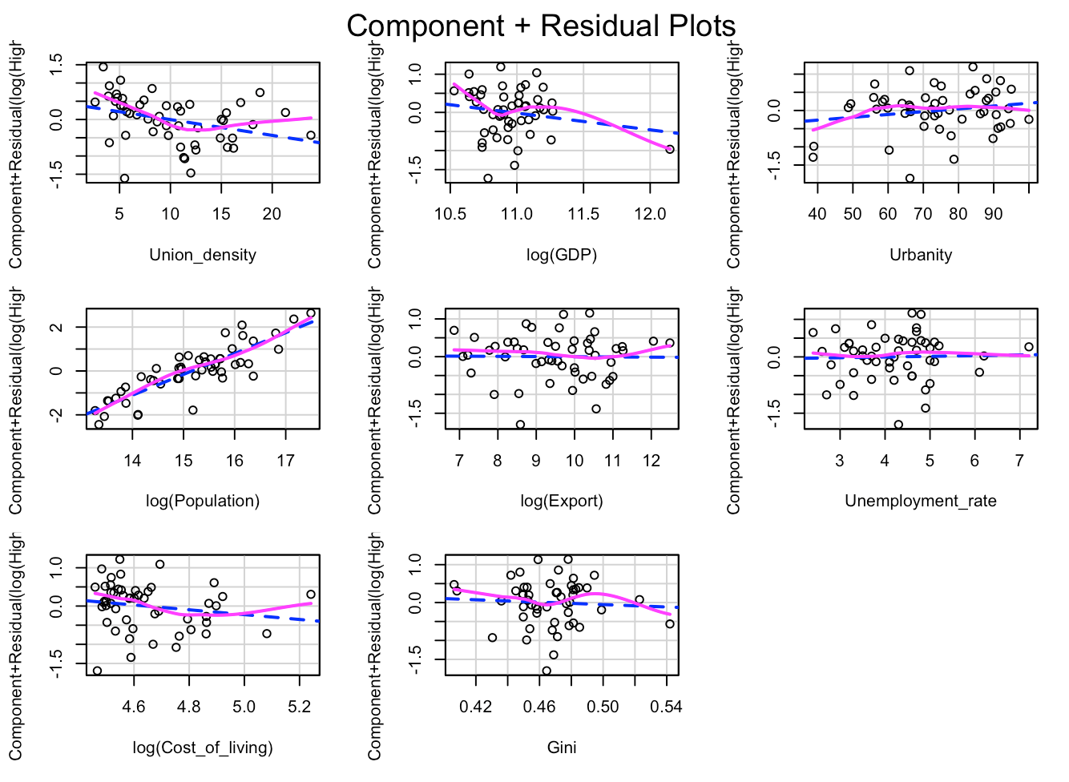
Component Residual Plots
Much better CrPlots
Still an leverage point (DC)
Sensitivity analysis
Curve?
Notes:
Smoothe trend of the variables. Curve pattern, we did not look into it.

Slide 12
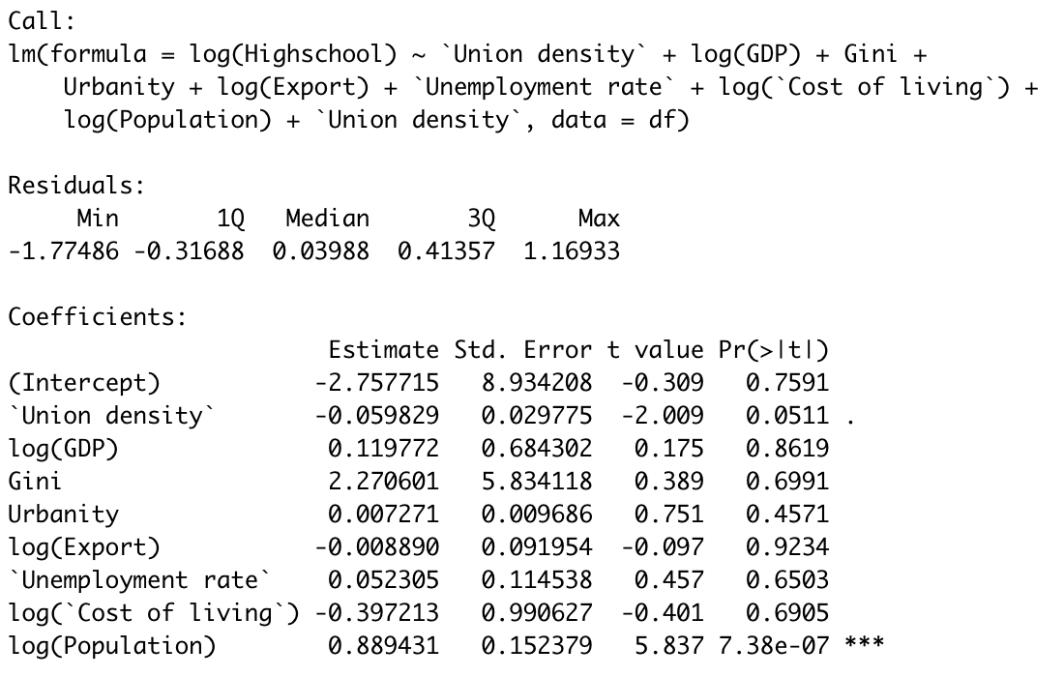
Sensitivity Analysis
Noticeable changes in the result of coefficient.
Cannot simply leave the outlier out.
Coefficient is still close to zero.
Notes:
Cannot leave out the outliers, it might introduce bias.

Slide 13
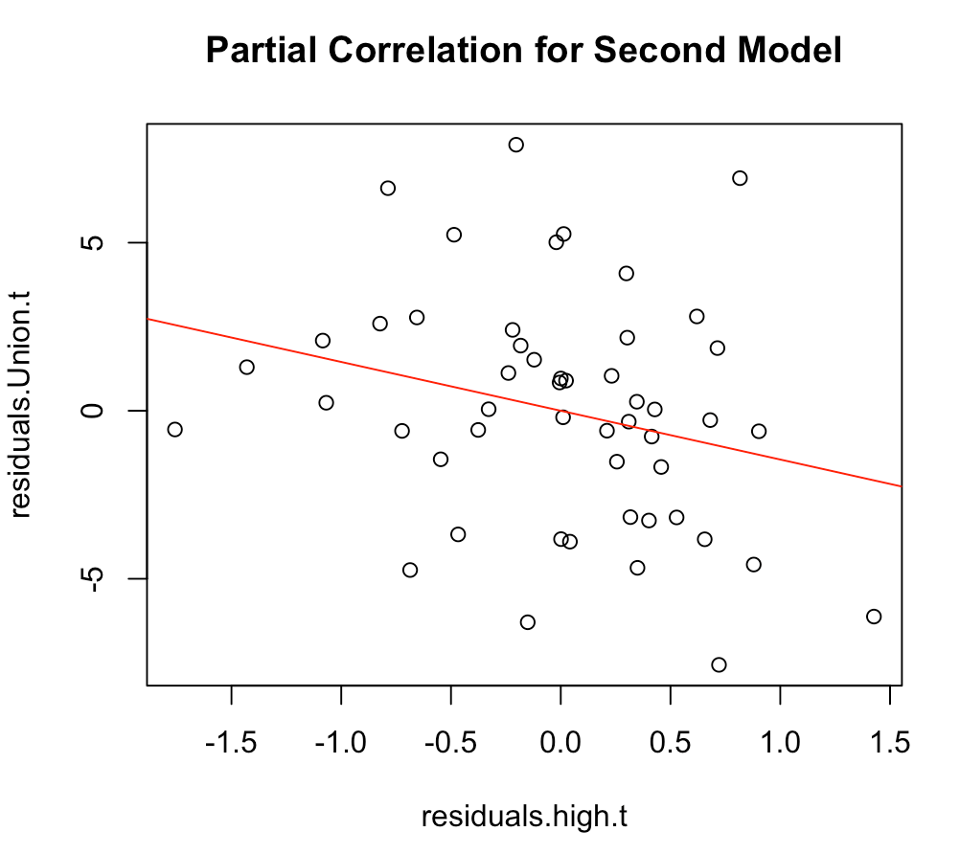
Partial Correlation Test
Control for confounding variables (after transformation)
Pearson
Estimate: -0.2631
P-value = 0.0622
Spearman
Estimate: -0.3088
P-value = 0.0274

Slide 14
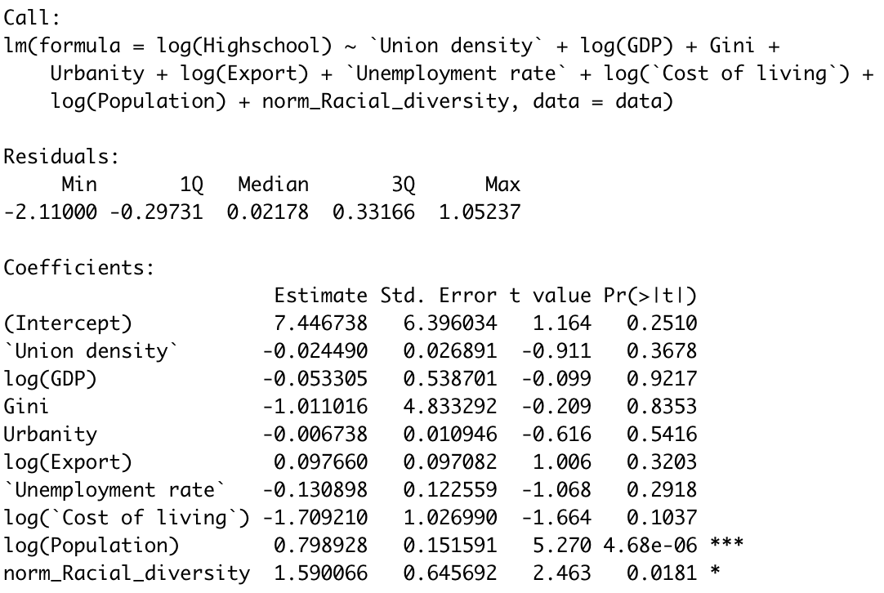
Adding Racial Diversity
Outcome: log(Highschool)
Predictor: Union density
Variable:
Racial Diversity =
1 - (Black^2 + White^2 + Hispanic^2)
2. Normalize Racial Diversity =
C/(C-1) * Racial Diversity
Reference: David V, Mia Budescu. How to Measure Diversity When You Must (2012)
Notes:
Why do you want to normalize racial diversity
source

Slide 15
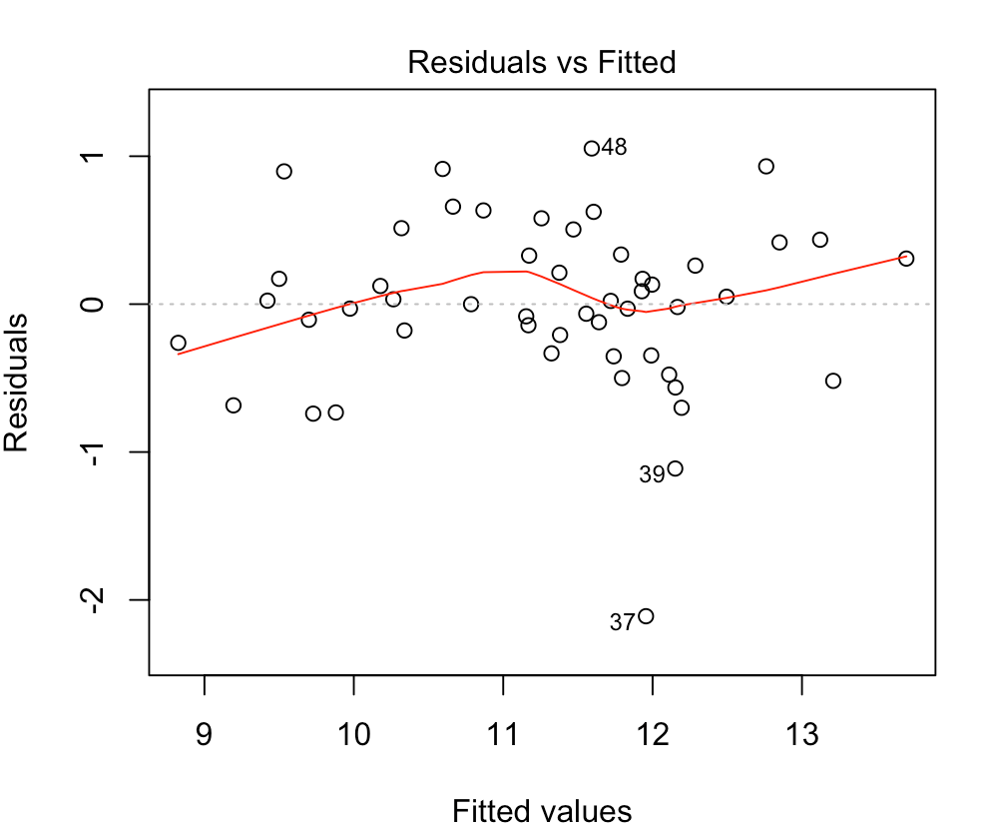
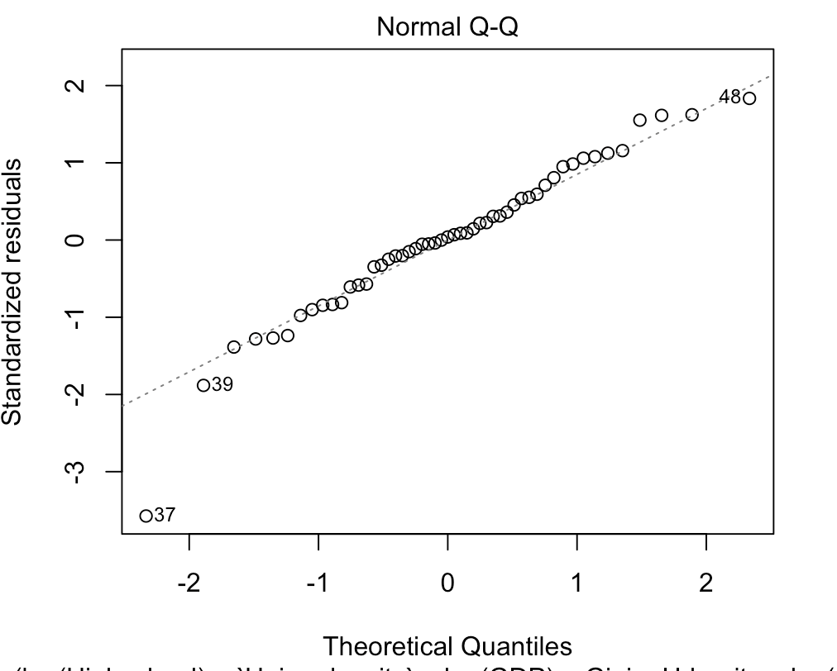
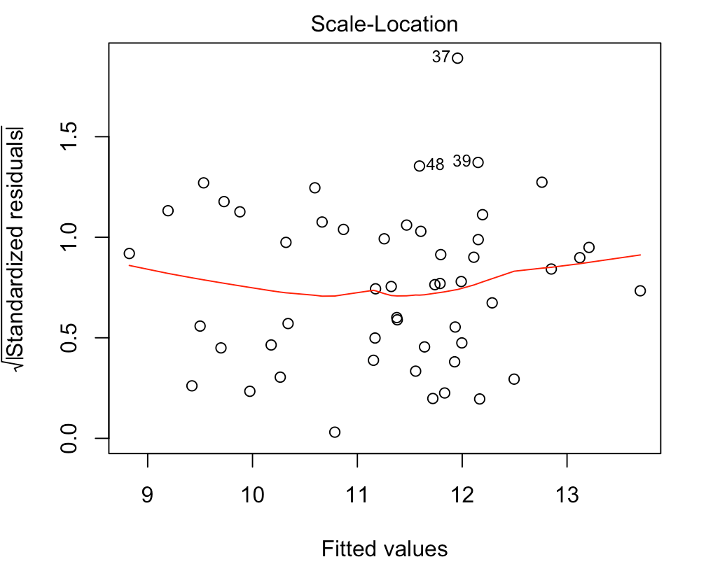
Model Check
Adjusted R^2 = 0.7503
Normality Assumption
Linearity Assumption
Constant Variance Assumption

Slide 16
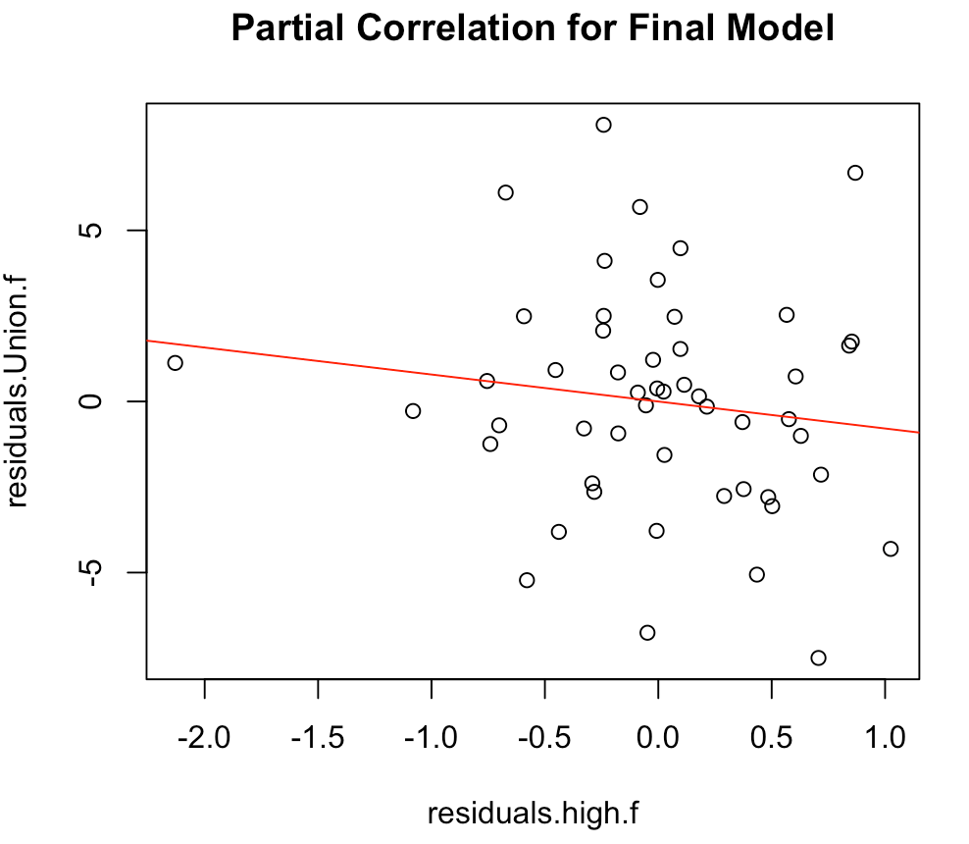
Partial Correlation Test
Control for confounding variables (add racial diversity)
Pearson
Estimate: -0.1382
P-value = 0.069
Spearman
Estimate: -0.1228
P-value = 0.3906

Slide 17
Conclusion
More consistent data might be helpful
Model with transformed variables
No significant relationship between vocational education and union density
Adding Racial Diversity helps a little in explaining the relationship between vocational education and union density, but we do not have a conclusive information here

